Slide 1

Linear Regression
Notes:
‹#›

Slide 2
Objectives
What is linear regression?
How does linear regression work?
When to use linear regression?

Slide 3
What is Linear Regression?
Supervised machine learning algorithm.
This algorithm finds the best fit linear line between independent and dependent variables.
In other words, the algorithm identifies the linear relationship between the dependent and independent variables.
Two types of linear regression.
Simple linear regression is where one independent variable is used for the model to identify a relationship.
Multiple linear regressions is where multiple independent variables are used for the model to identify a relationship.

Slide 4
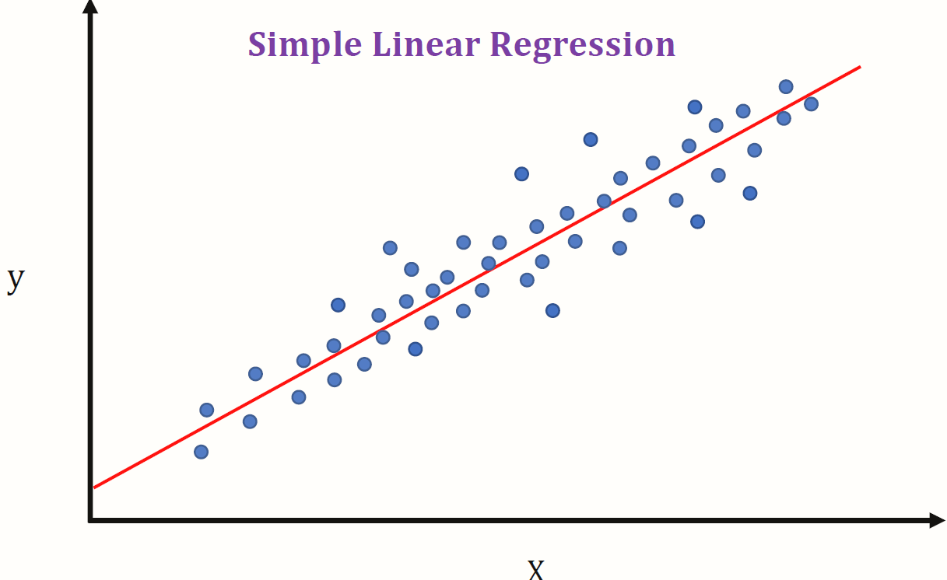
How Does Linear Regression Work?
Goal: find the best fit linear line and the optimal values of intercept and coefficients such that error is minimized.
Given the independent variable on the x-axis and the dependent variable on the y-axis, the line of best fit is predicted by the model and fit on the graph.
The linear regression model will fit the predicted line of best fit on the test data and will then be evaluated after it has been trained.

Slide 5
When to Use Linear Regression?
When given a dataset with labeled data, linear regression can be utilized to predict the value of a dependent variable given an independent variable.
Utilize linear regression when trying to predict a continuous value rather than a class.
When utilizing one independent variable, use simple linear regression and when utilizing multiple independent variables, use multiple regression.

